Slide 1
Advanced Analysis
Søren H. Welling, Pharmatronics
Agnes Martine Nielsen, DTU Compute

Slide 2
Who are we?

Slide 3
Agenda
Introduction to Machine Learning
Sparse and Regularized Regression and Classification
Model Selection Exercise
Ensemble Methods
Random Forest Exercise
Diagnostics

Slide 4
Introduction to Machine Learning
Søren H. Welling, Pharmatronics
Agnes Martine Nielsen, DTU Compute

Slide 5
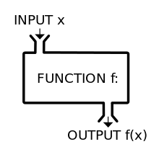
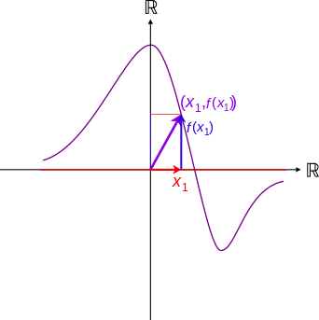
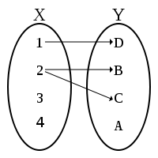
What is a model?
It is a plot…
It is a machine…
It is a mapping…
Output
Input

Slide 6
Visualization of data
Output
Two column data set
… or matrix
SOT | SOD
0 | 4
.2 | 3.8
1 | 7
2 | 12
3 | 13
5 | 7
9 | 2
… | …
Skills on the dance floor (points of awesomeness)
Input
Shots of tequila (2cl, 35%w/V)

Slide 7
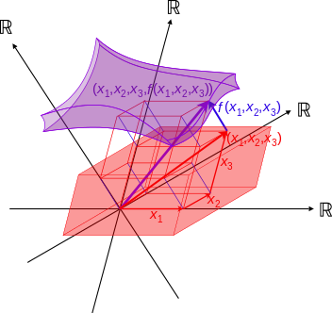
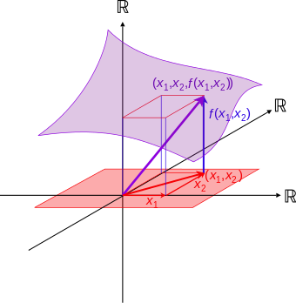
Multivariate functions / statistics
Output
Input 3
Output 1
Output
Input 2
Input 2
Input 1
Input 1
Input 1
SOT | SOD
0 | 4
.2 | 3.8
1 | 7
2 | 12
3 | 13
5 | 7
9 | 2
… | …
SOT | SOD | SDC
0 | 4 | 5
.2 | 3.8 | 5
1 | 7 | 4
2 | 12 | 3
3 | 13 | 2
5 | 7 | 1
9 | 2 | ½
… | … | …
SOT | SOD | SDC | BMI
0 | 4 | 5 | 28
.2 | 3.8 | 5 | 18
1 | 7 | 4 | 28
2 | 12 | 3 | 27
3 | 13 | 2 | 35
5 | 7 | 1 | 17
9 | 2 | ½ | 42
… | … | … | …
2D
3D
4D

Slide 8
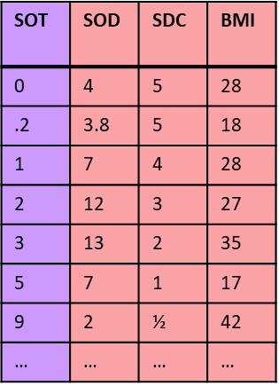


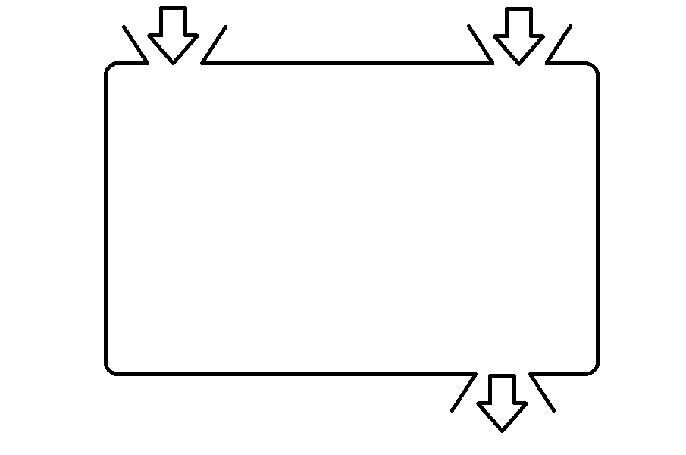
a learner…
a useful model:
dataset
tweak parameters
Learning
algorithm
model

Slide 9
a learner…
a useful model:
dataset
tweak parameters
Learning
algorithm
model

Slide 10
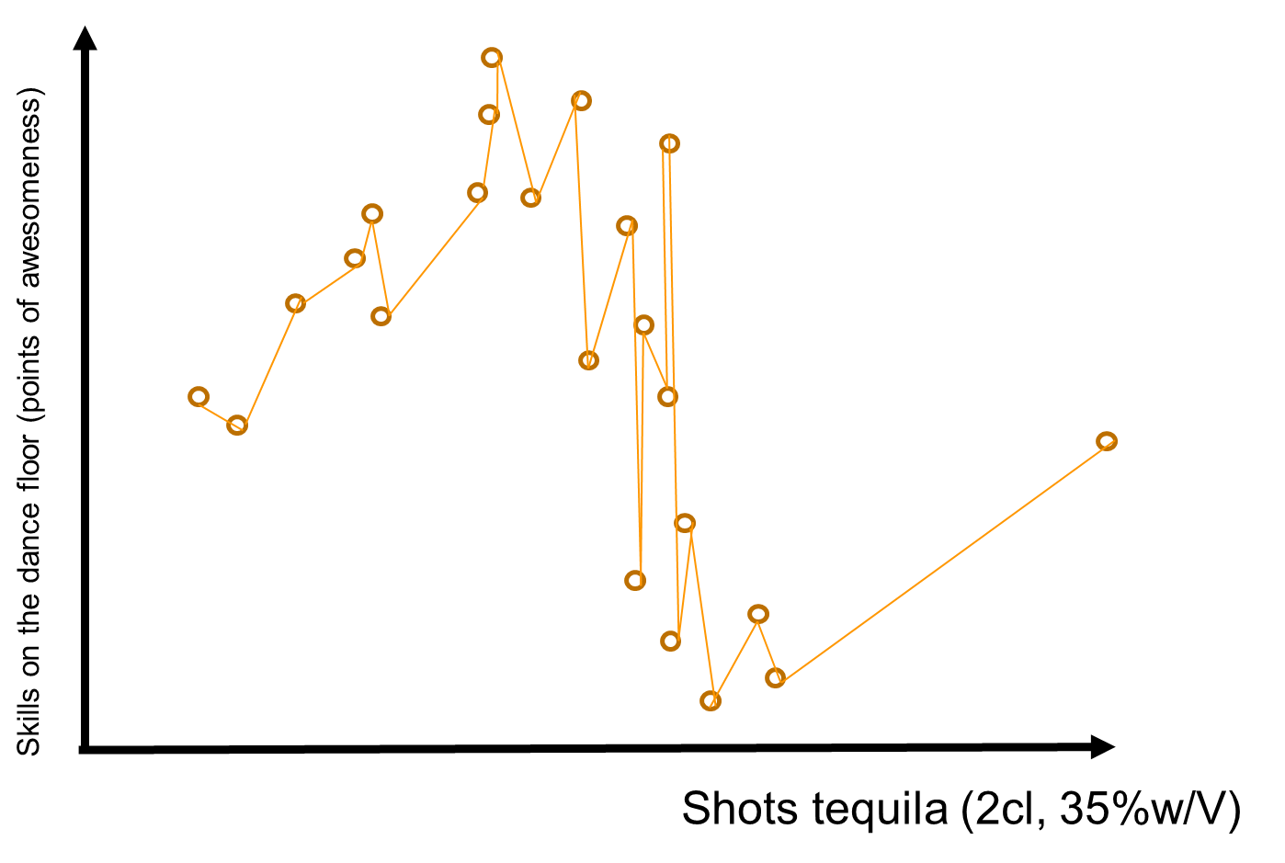
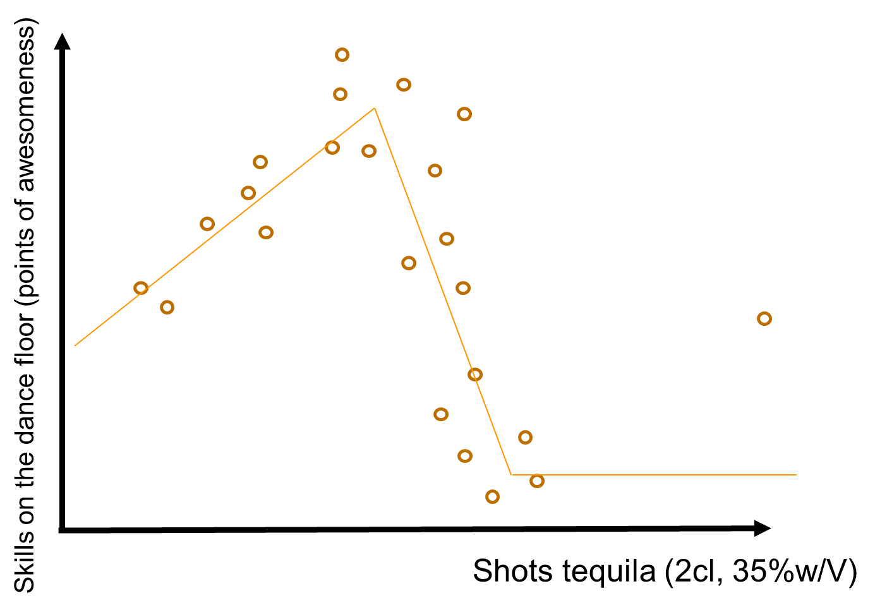
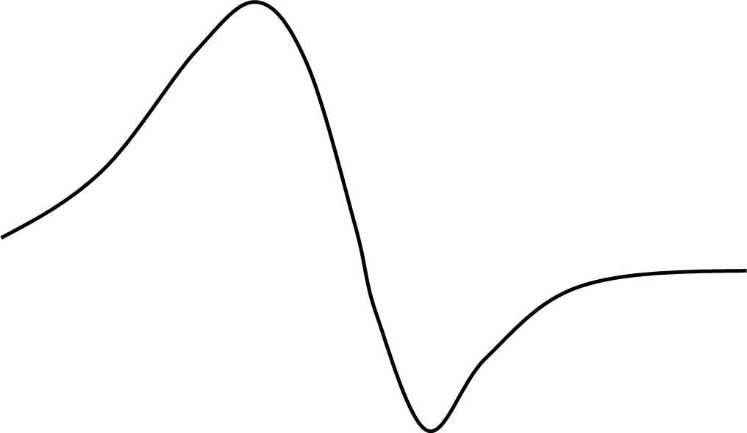

Slide 11
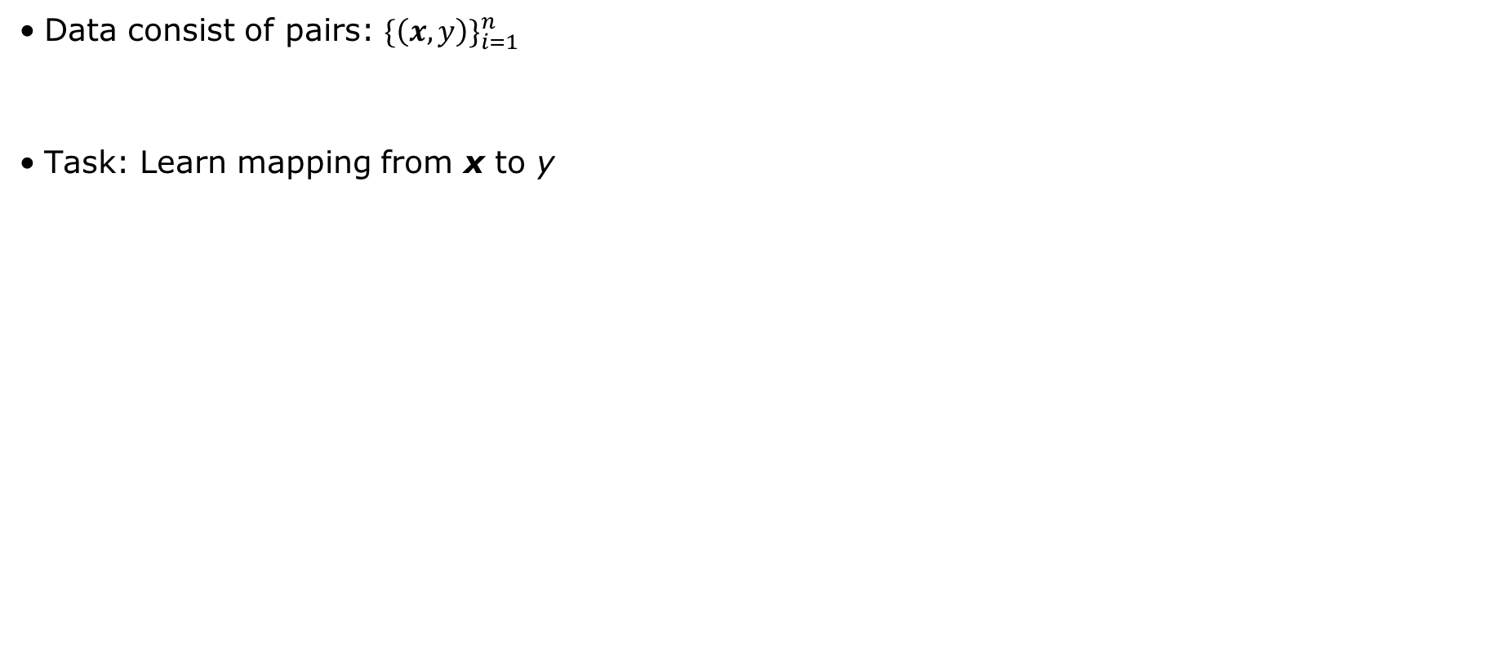
Supervised Learning
Data consist of pairs: ${\{\left(x,y\right)\}}_{i=1}^{n}$
Task: Learn mapping from x to y
features
response
y
x₂
Regression
x₁
Classification
x₁

Slide 12
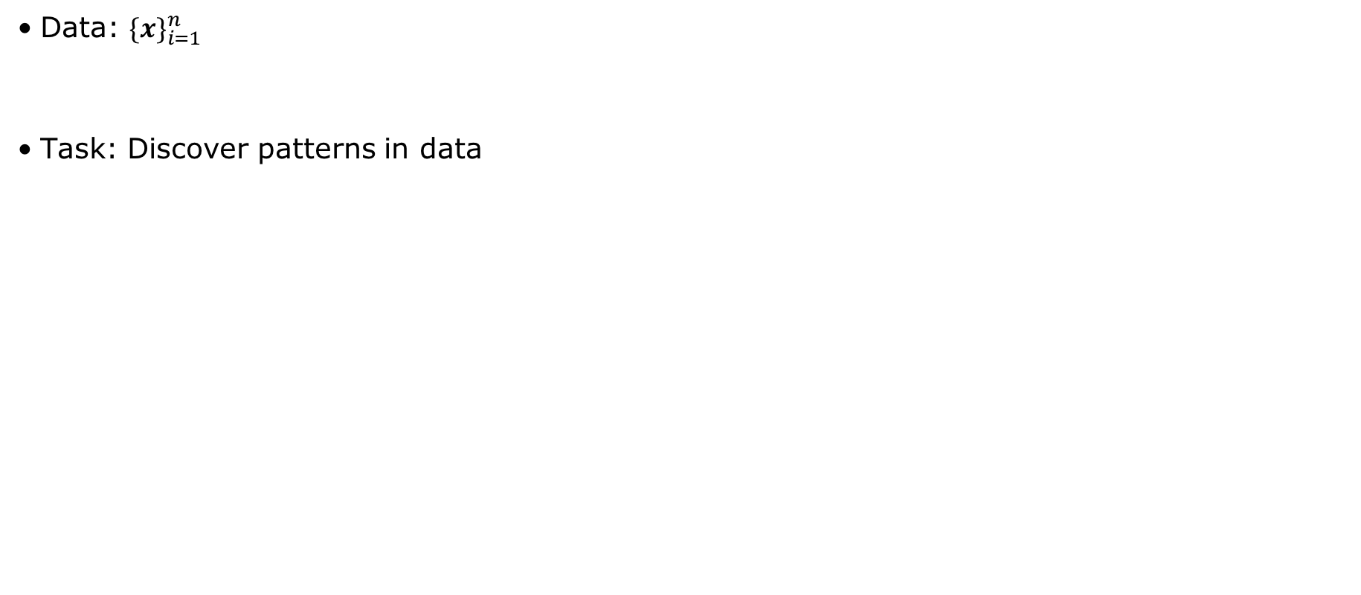
Unsupervised Learning
Data: ${\{x\}}_{i=1}^{n}$
Task: Discover patterns in data
features
x₂
x₁

Slide 13
Parametric vs. non-parametric
x₂
Parametric: Number of parameters is constant with more data E.g. linear classifier
Non-parametric: Number of parameters grows with more data E.g. k Nearest Neighbor classifier
x₁
x₂
x₁

Slide 14
Machine Learning
Other
Supervised
Unsupervised
Parametric
Logistic regression
Linear discriminant analysis
+ Simple
+ Fast
+ Need little data
- Constrained
- Limited complexity - Poor fit
#parameters constant with more data
Linear regression
Gaussion Mixture Models
Non-Parametric
+ Flexible
+ Power
+ Performance
- Need more data
- Slow - Overfitting
kNN classifier
Kernel SVM
Regression Trees
Random forest
#parameters grows with more data
Hierarchical Clustering
Classification
Regression

Slide 15
Curse of Dimensionality
As the number of features (or dimensions) grows, the amount of data we need to generalize accurately grows exponentially
x₂
x₂
x₃
x₁
x₁
x₁
1/10
1/100
1/1000

Slide 16
Over fitting & under fitting

Slide 17
Some true hidden function
Test error
Test error
Training error
Test error
Training error
Training error
Training error

Slide 18
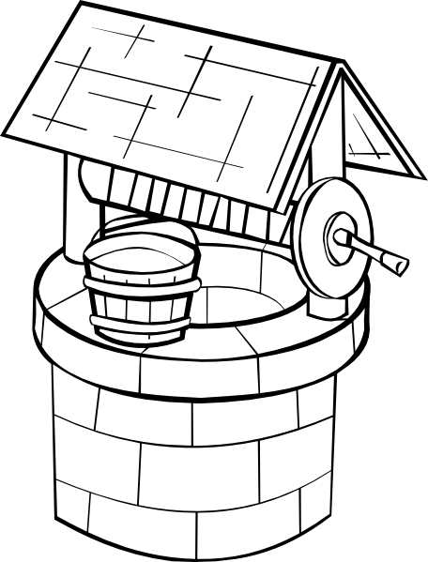
How do we estimate future model performance?
Training set
Test set
Another test set
(those predictions we made, when we promised the investors, that our model really works! and they invested a lot of money in our predictions, so we really hope
the model still represents samples drawn from the well or that we will find new jobs somewhere else)

Slide 19
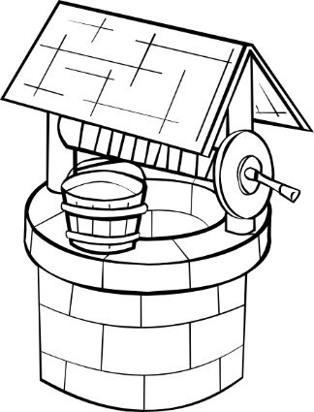
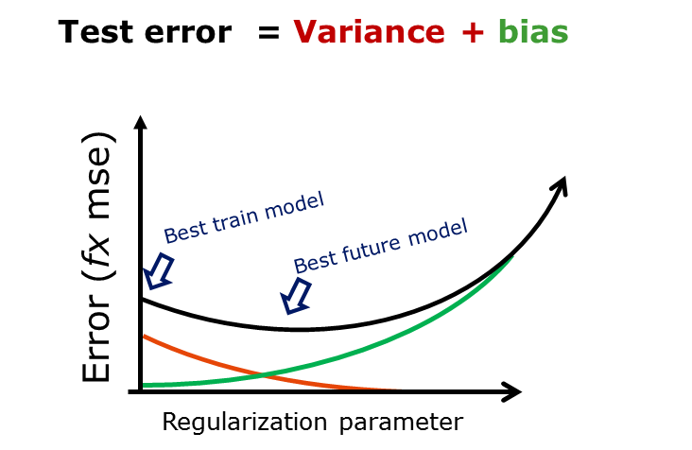
What do sample from the well?
Robust
Noise – resistant
bias
Non-reproducible
random noise
+
Flexibility
Adaptiveness
variance
reproducible
persistent pattern
+ fixed error

Slide 20
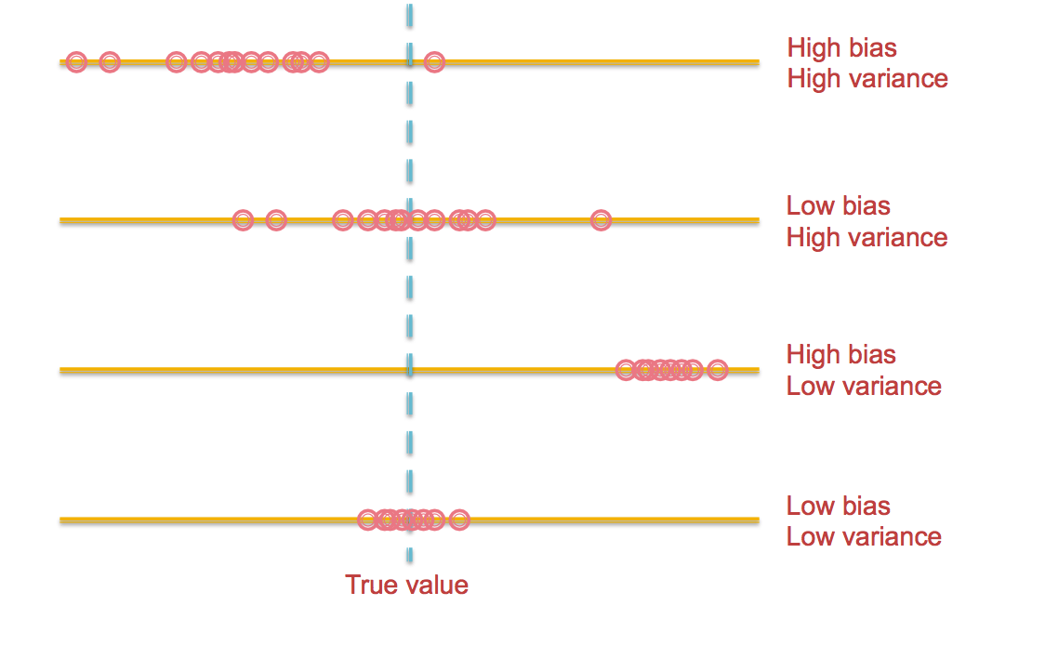
Variance and bias

Slide 21
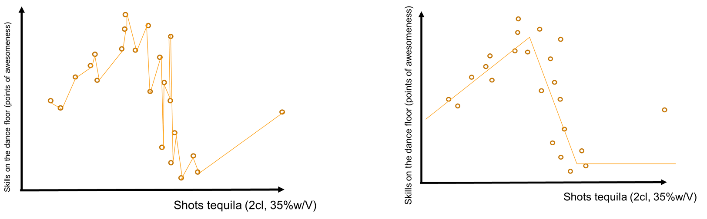
+ fixed error
dataset
tweak parameters
Learning
algorithm
model

Slide 22
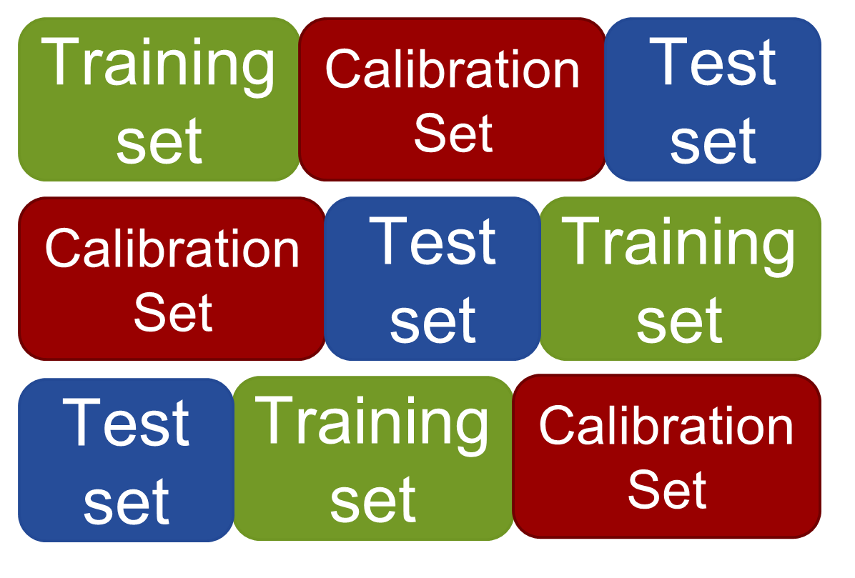
Cross validation
Training set
Calibration
Set
Test
set
Training set
Calibration
Set
Test
set
Calibration
Set
Test
set
Training set
Calibration
Set
Test
set
Training set
Data set
Training set
Test
set
Training set
Calibration
Set
Test
set
Training set
Calibration
Set
Training set
Test
set
Future
Test set
Data set
Training set
Calibration
Set
Test
set

Slide 23

Break!

Slide 24
Sparse and Regularized Regression and Classification
Modifying Simple Methods
Søren H. Welling, Pharmatronics
Agnes Martine Nielsen, DTU Compute

Slide 25
Curse of Dimensionality
As the number of features (or dimensions) grows, the amount of data we need to generalize accurately grows exponentially
x₂
x₂
x₃
x₁
x₁
x₁
1/10
1/100
1/1000

Slide 26
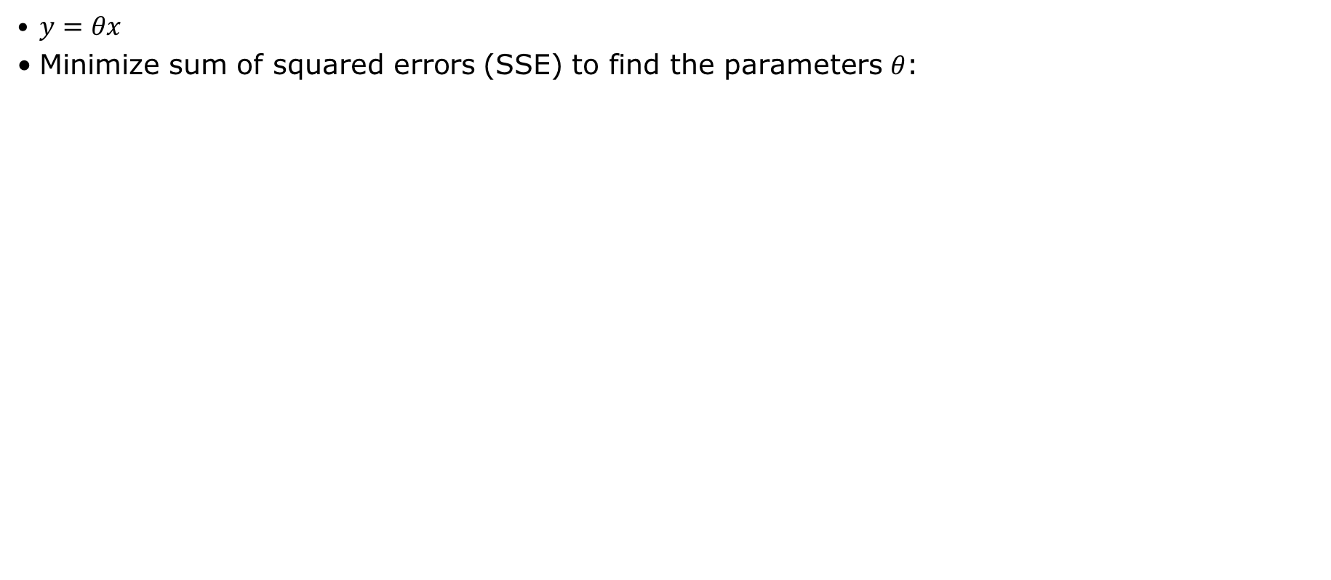
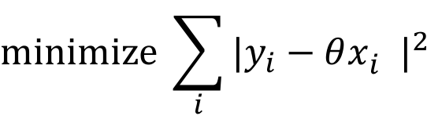
Ordinary Least Squares
$y=θx$
Minimize sum of squared errors (SSE) to find the parameters $θ$:
$$minimize \sum_{i}{{|y_{i}−θx_{i}^{}|}^{2}}$$
SSE
UNBIASED!

Slide 27
Example: Diabetes
442 observations, 10 variables
Response is disease progress one year after baseline
Variables include clinical measures, e.g. age, sex and BMI

Slide 28
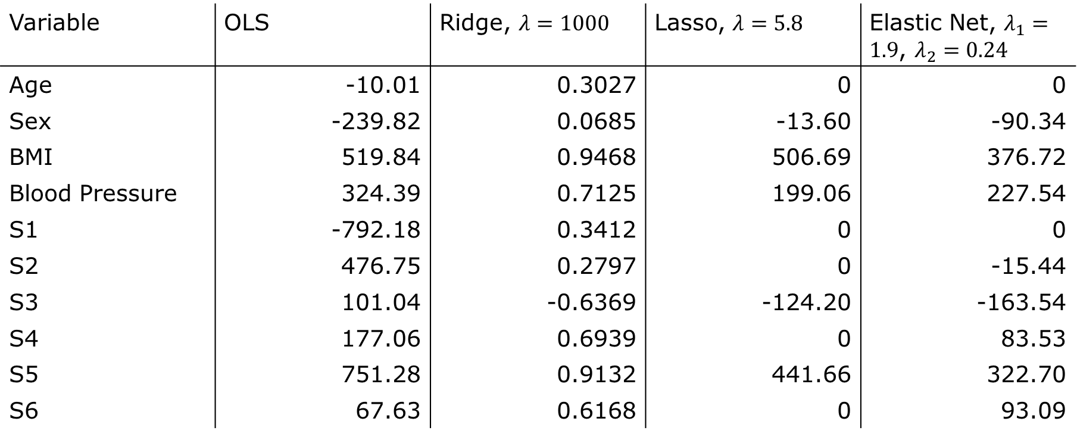
Example: Diabetes
Variable | OLS | Ridge, $λ=1000$ | Lasso, $λ=5.8$ | Elastic Net, $λ_{1}=1.9$, $λ_{2}=0.24$
Age | -10.01 | 0.3027 | 0 | 0
Sex | -239.82 | 0.0685 | -13.60 | -90.34
BMI | 519.84 | 0.9468 | 506.69 | 376.72
Blood Pressure | 324.39 | 0.7125 | 199.06 | 227.54
S1 | -792.18 | 0.3412 | 0 | 0
S2 | 476.75 | 0.2797 | 0 | -15.44
S3 | 101.04 | -0.6369 | -124.20 | -163.54
S4 | 177.06 | 0.6939 | 0 | 83.53
S5 | 751.28 | 0.9132 | 441.66 | 322.70
S6 | 67.63 | 0.6168 | 0 | 93.09
Notes:
CV lambda = 0.0068926

Slide 29
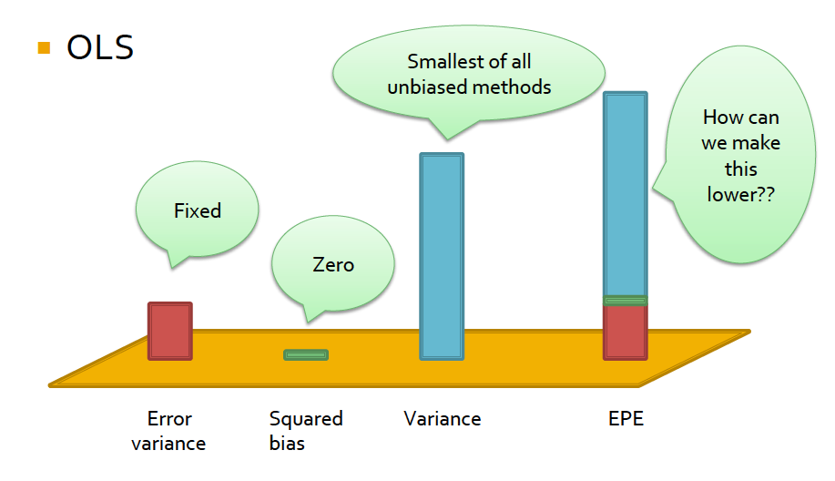
Expected Prediction Error

Slide 30
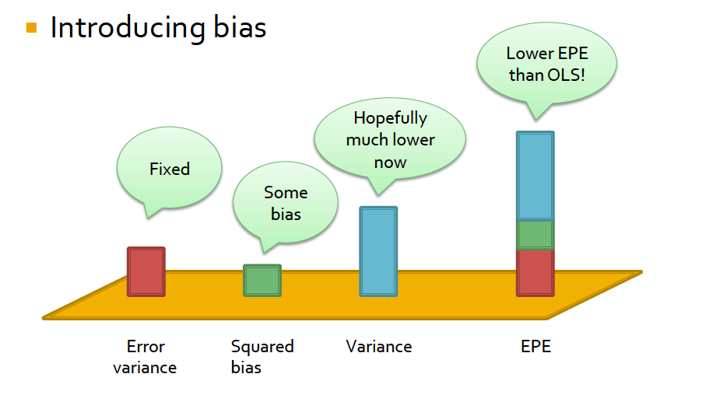
Introducing bias lowers the over all EPE

Slide 31
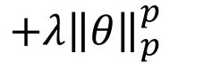
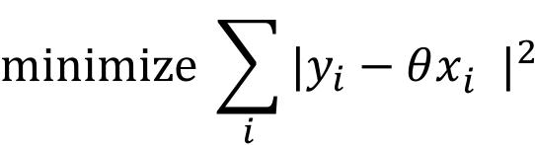
Penalized Linear Regression introduces bias
Minimize sum of squared errors (SSE) AND a penalty term
$$minimize \sum_{i}{{|y_{i}−θx_{i}^{}|}^{2}}$$
$${+λ{\left\|θ\right\|}_{p}^{p}}_{}$$

Slide 32
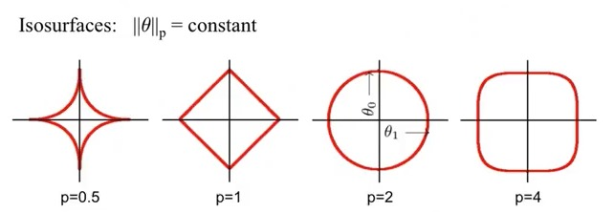
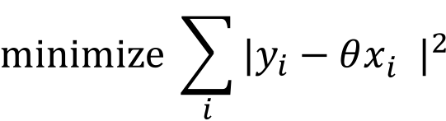
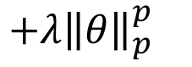
Norms of parameters can be used for penalizing
$$minimize \sum_{i}{{|y_{i}−θx_{i}^{}|}^{2}}$$
$${+λ{\left\|θ\right\|}_{p}^{p}}_{}$$
Lasso
Ridge

Slide 33
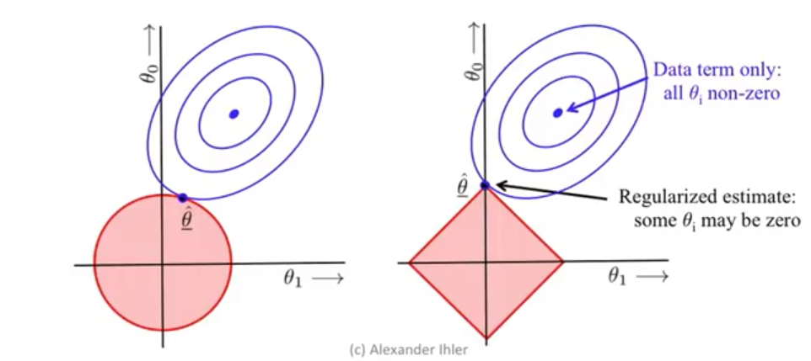
The solution is a compromise

Slide 34
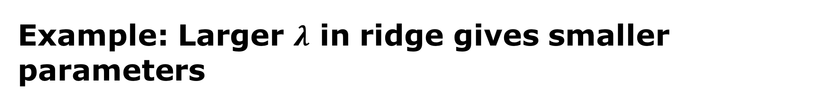
Example: Larger $λ$ in ridge gives smaller parameters
Ridge Regression

Slide 35
Example: Ridge regression has smaller parameters
Variable | OLS | Ridge, $λ=1000$ | Lasso, $λ=5.8$ | Elastic Net, $λ_{1}=1.9$, $λ_{2}=0.24$
Age | -10.01 | 0.3027 | 0 | 0
Sex | -239.82 | 0.0685 | -13.60 | -90.34
BMI | 519.84 | 0.9468 | 506.69 | 376.72
Blood Pressure | 324.39 | 0.7125 | 199.06 | 227.54
S1 | -792.18 | 0.3412 | 0 | 0
S2 | 476.75 | 0.2797 | 0 | -15.44
S3 | 101.04 | -0.6369 | -124.20 | -163.54
S4 | 177.06 | 0.6939 | 0 | 83.53
S5 | 751.28 | 0.9132 | 441.66 | 322.70
S6 | 67.63 | 0.6168 | 0 | 93.09
Notes:
CV lambda = 0.0068926

Slide 36
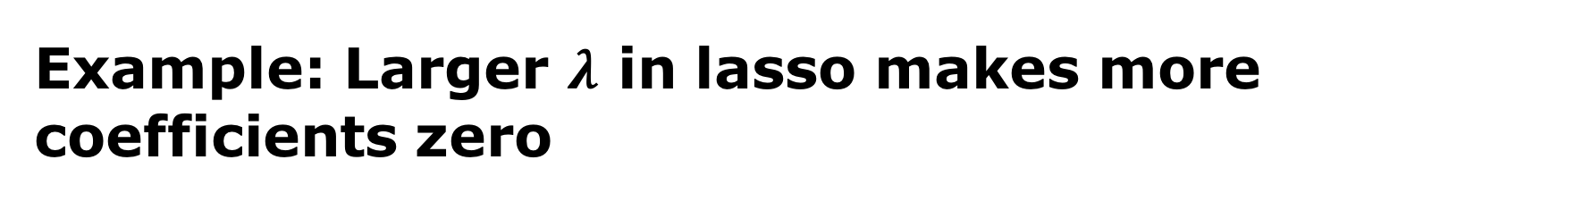
Example: Larger $λ$ in lasso makes more coefficients zero
Lasso Regression

Slide 37
Example: Lasso makes some parameters zero
Variable | OLS | Ridge, $λ=1000$ | Lasso, $λ=5.8$ | Elastic Net, $λ_{1}=1.9$, $λ_{2}=0.24$
Age | -10.01 | 0.3027 | 0 | 0
Sex | -239.82 | 0.0685 | -13.60 | -90.34
BMI | 519.84 | 0.9468 | 506.69 | 376.72
Blood Pressure | 324.39 | 0.7125 | 199.06 | 227.54
S1 | -792.18 | 0.3412 | 0 | 0
S2 | 476.75 | 0.2797 | 0 | -15.44
S3 | 101.04 | -0.6369 | -124.20 | -163.54
S4 | 177.06 | 0.6939 | 0 | 83.53
S5 | 751.28 | 0.9132 | 441.66 | 322.70
S6 | 67.63 | 0.6168 | 0 | 93.09
Notes:
CV lambda = 0.0068926

Slide 38
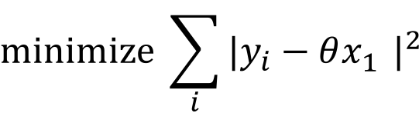
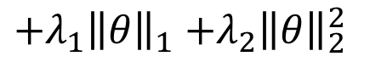
Elastic net is the best of both worlds
$$minimize \sum_{i}{{|y_{i}−θx_{1}^{}|}^{2}}$$
$${+λ_{1}\left\|θ\right\|}_{1}{+λ_{2}{\left\|θ\right\|}_{2}^{2}}_{}$$
Elastic Net

Slide 39
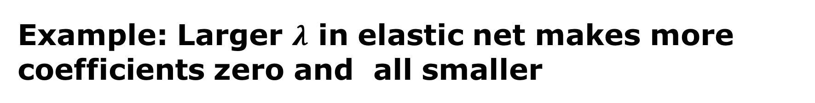
Example: Larger $λ$ in elastic net makes more coefficients zero and all smaller
Elastic Net
Notes:
Lambda1 = lambda*alpha
Lambda2 = lambda*(1-alpha)/2

Slide 40
Example: Coefficients are a compromise
Variable | OLS | Ridge, $λ=1000$ | Lasso, $λ=5.8$ | Elastic Net, $λ_{1}=1.9$, $λ_{2}=0.24$
Age | -10.01 | 0.3027 | 0 | 0
Sex | -239.82 | 0.0685 | -13.60 | -90.34
BMI | 519.84 | 0.9468 | 506.69 | 376.72
Blood Pressure | 324.39 | 0.7125 | 199.06 | 227.54
S1 | -792.18 | 0.3412 | 0 | 0
S2 | 476.75 | 0.2797 | 0 | -15.44
S3 | 101.04 | -0.6369 | -124.20 | -163.54
S4 | 177.06 | 0.6939 | 0 | 83.53
S5 | 751.28 | 0.9132 | 441.66 | 322.70
S6 | 67.63 | 0.6168 | 0 | 93.09
Notes:
CV lambda = 0.0068926

Slide 41
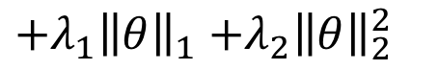
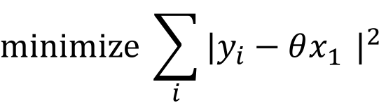
Elastic net
$$minimize \sum_{i}{{|y_{i}−θx_{1}^{}|}^{2}}$$
$${+λ_{1}\left\|θ\right\|}_{1}{+λ_{2}{\left\|θ\right\|}_{2}^{2}}_{}$$
SSE
Lasso
Ridge

Slide 42
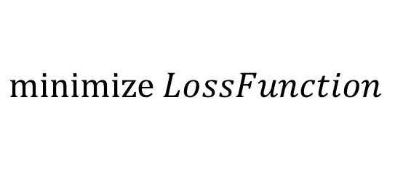
Same principle can be used in classification
$$minimize LossFunction$$
$${+λ_{1}\left\|θ\right\|}_{1}{+λ_{2}{\left\|θ\right\|}_{2}^{2}}_{}$$

Slide 43
Sparse/Regularized classification examples
Logistic regression with quadratic/L₁-penalized regularization
Regularized discriminant analysis (RDA)
Sparse discriminant analysis (SDA)

Slide 44
Exercise: Model Selection
On learnmore:
learnmore1.imm.dtu.dk
learnmore2.imm.dtu.dk.

Slide 45
Break!

Slide 46
Ensemble Methods
Combining Weak Methods
Søren H. Welling, Pharmatronics
Agnes Martine Nielsen, DTU Compute

Slide 47
Ensemble methods combine methods
data
Learner 1
Learner 2
Learner 3
Train
X
Model
X
Model
X
Model
Mean
y
Test

Slide 48
Combine the same methods with bagging
data
random with replacement
Sample
Sample
…
Sample
Train
Learner
Learner
Learner
X
Model
X
Model
X
Model
Test
Mean
y

Slide 49
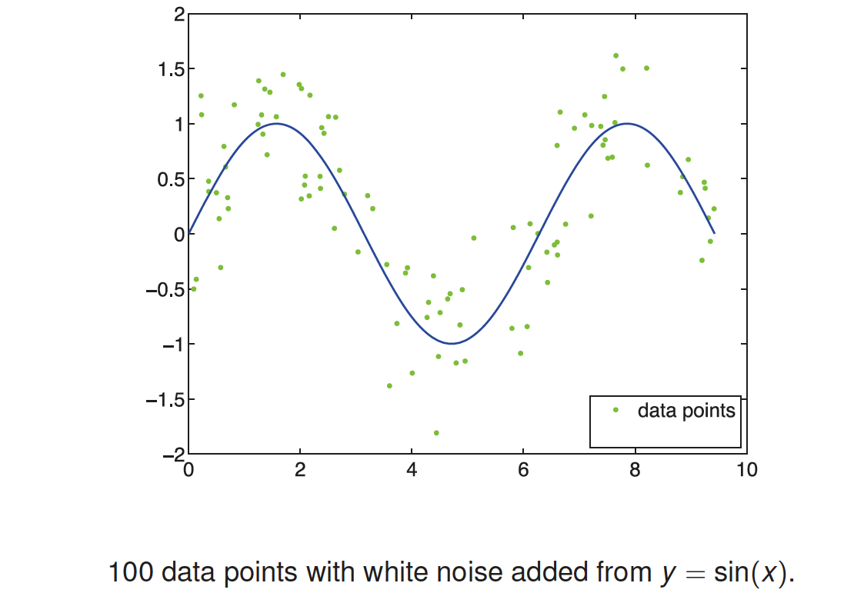
Example: Data comes from sin(x)

Slide 50
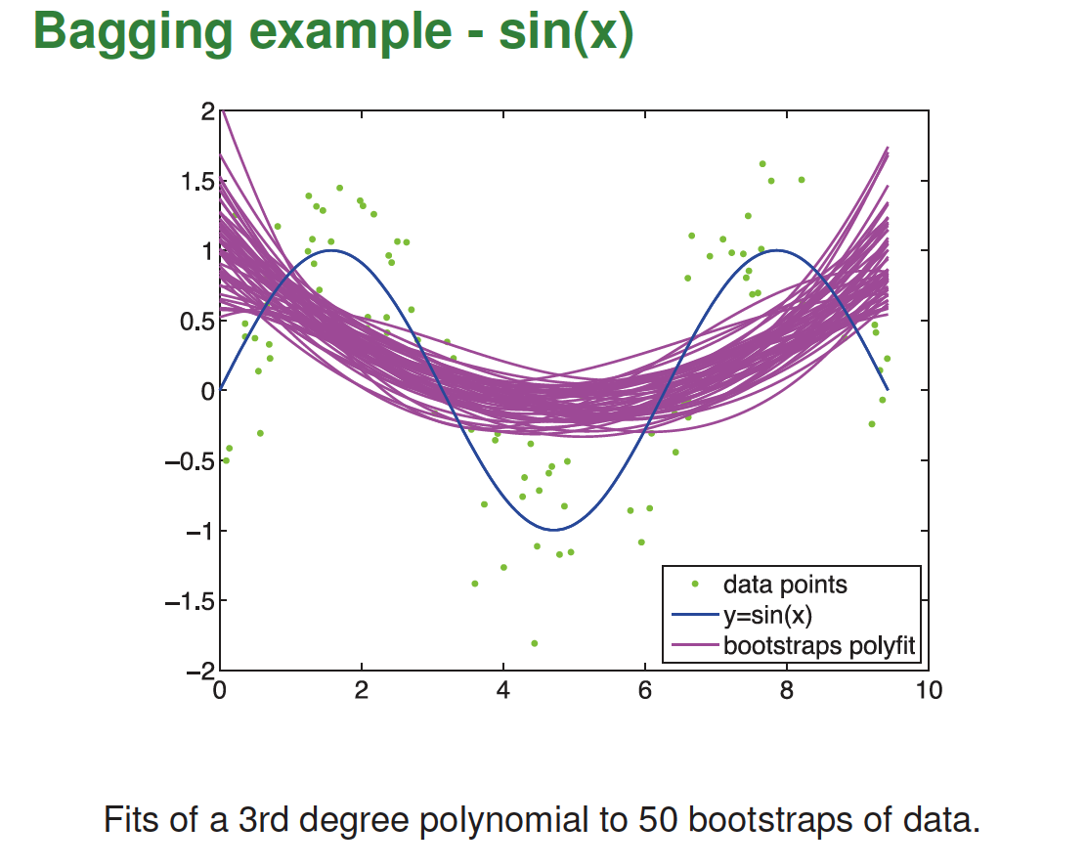
Bias of bagged method is the same as of original

Slide 51
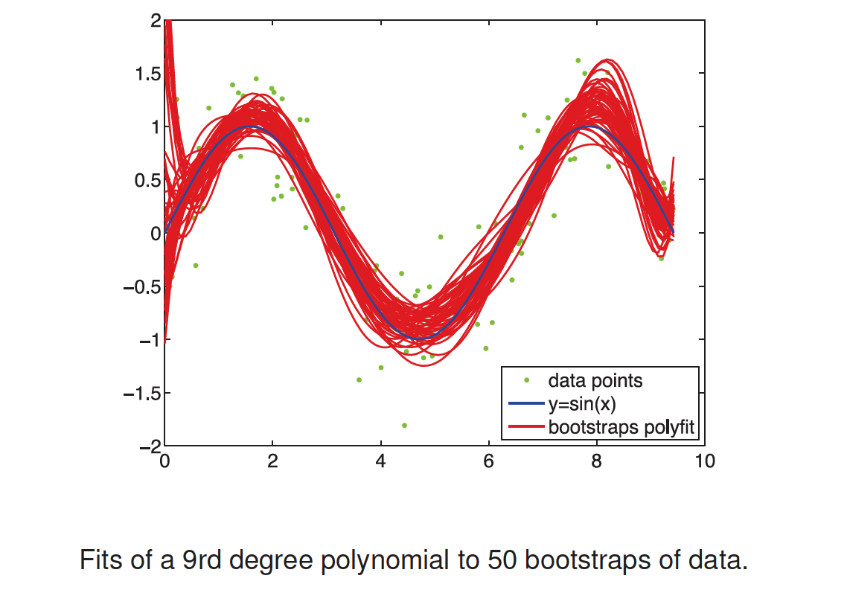
A flexible – low bias - method is needed

Slide 52
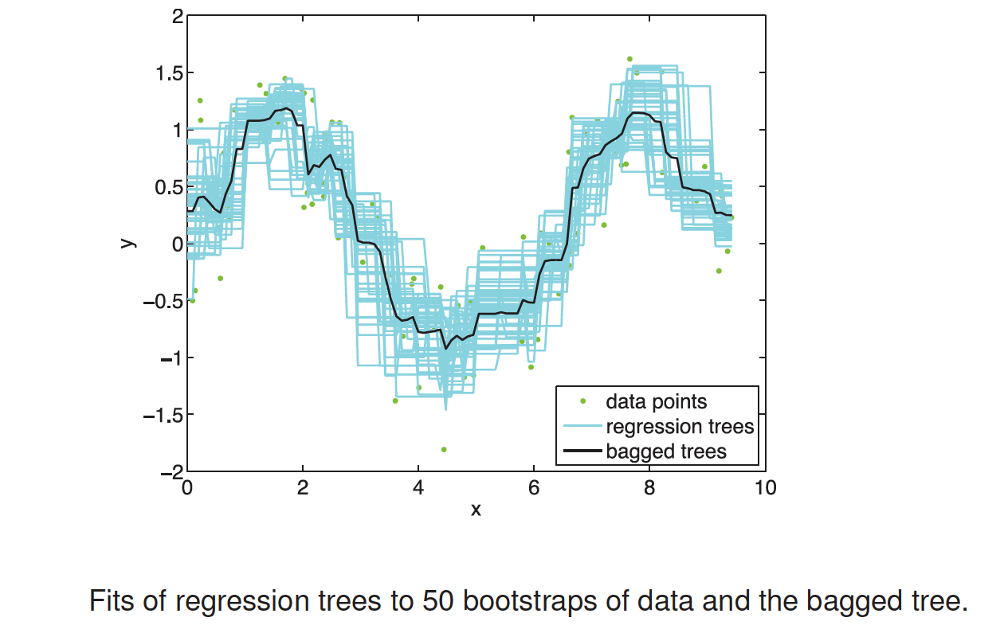
Bagging can reduce the variance

Slide 53
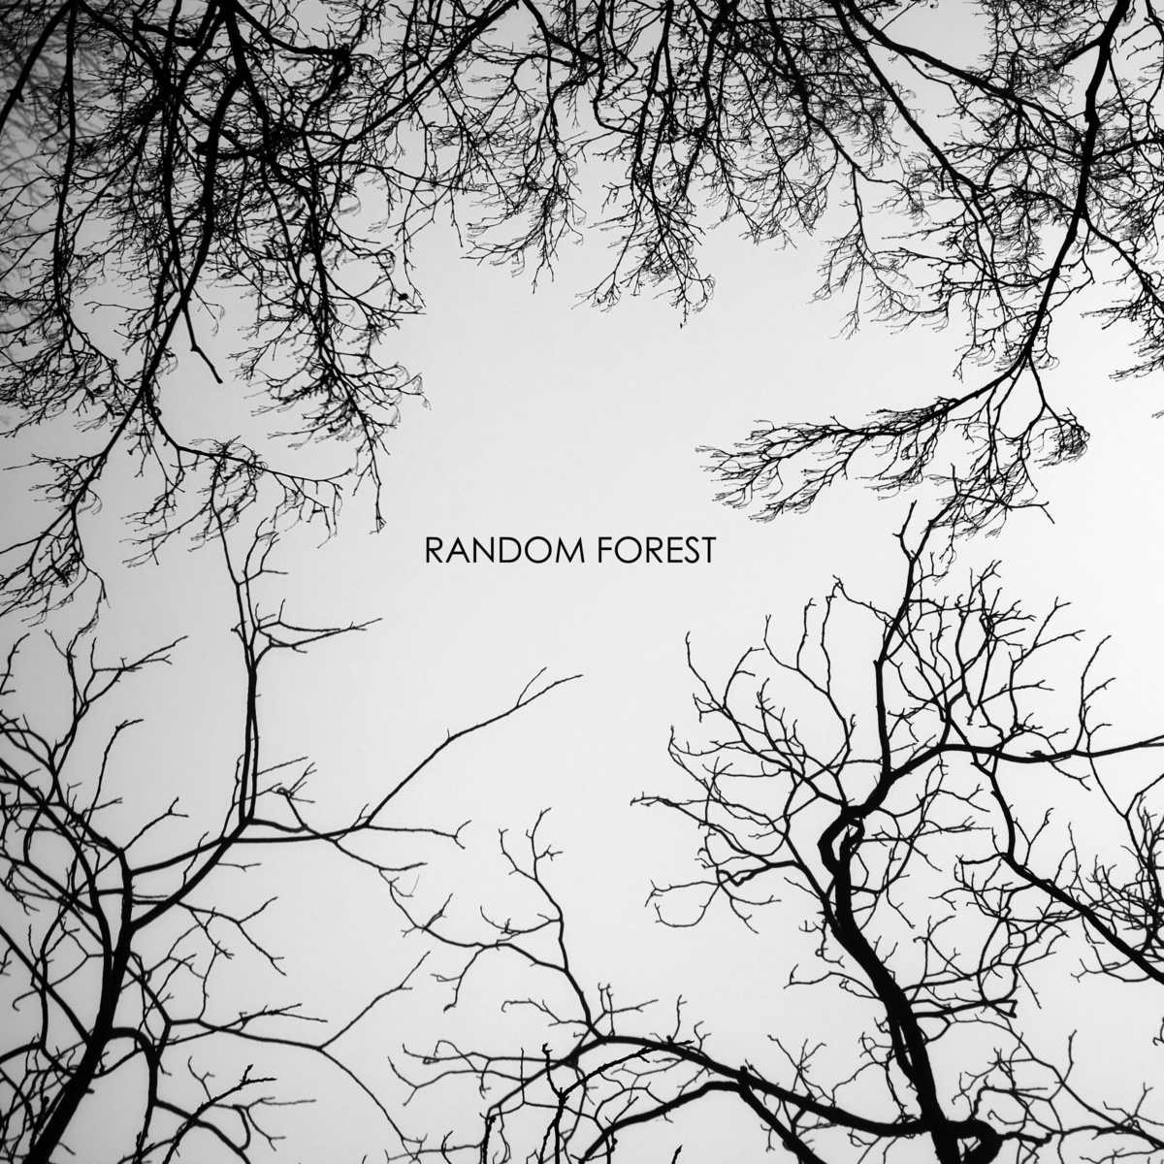
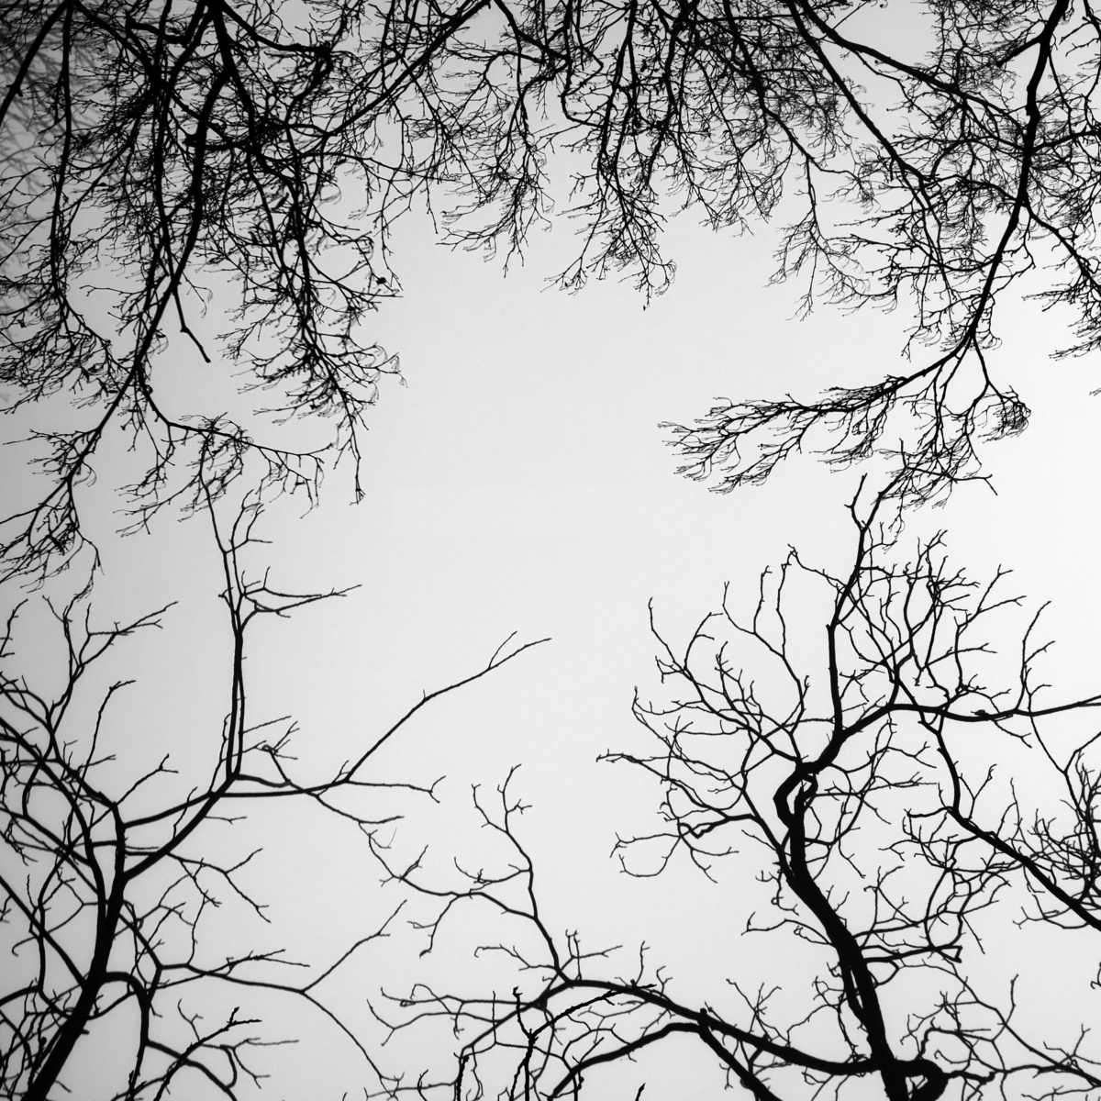

Slide 54


Slide 55


Slide 56
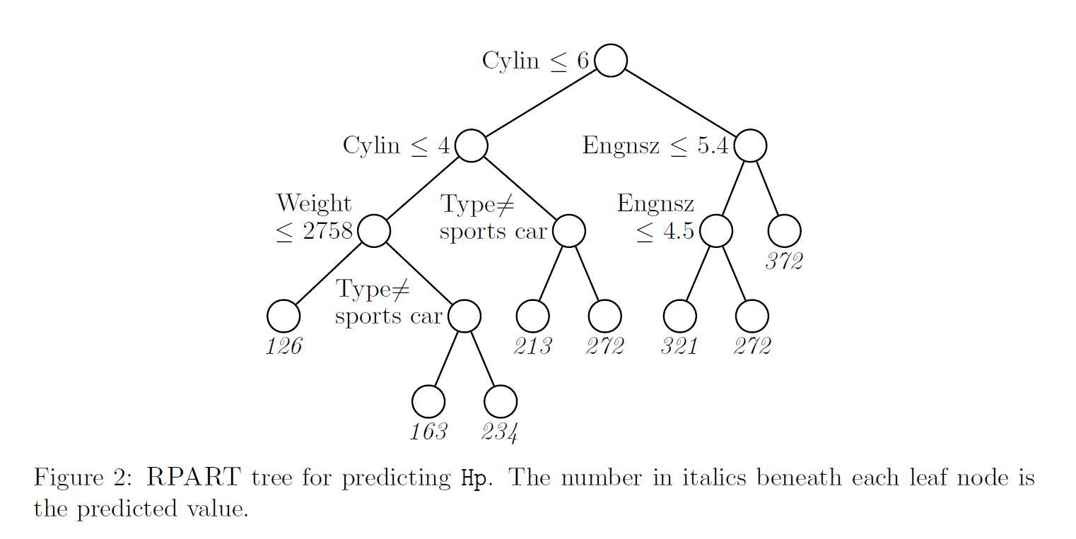
Model to predict car engine power (Hp) as function of car attributes

Slide 57
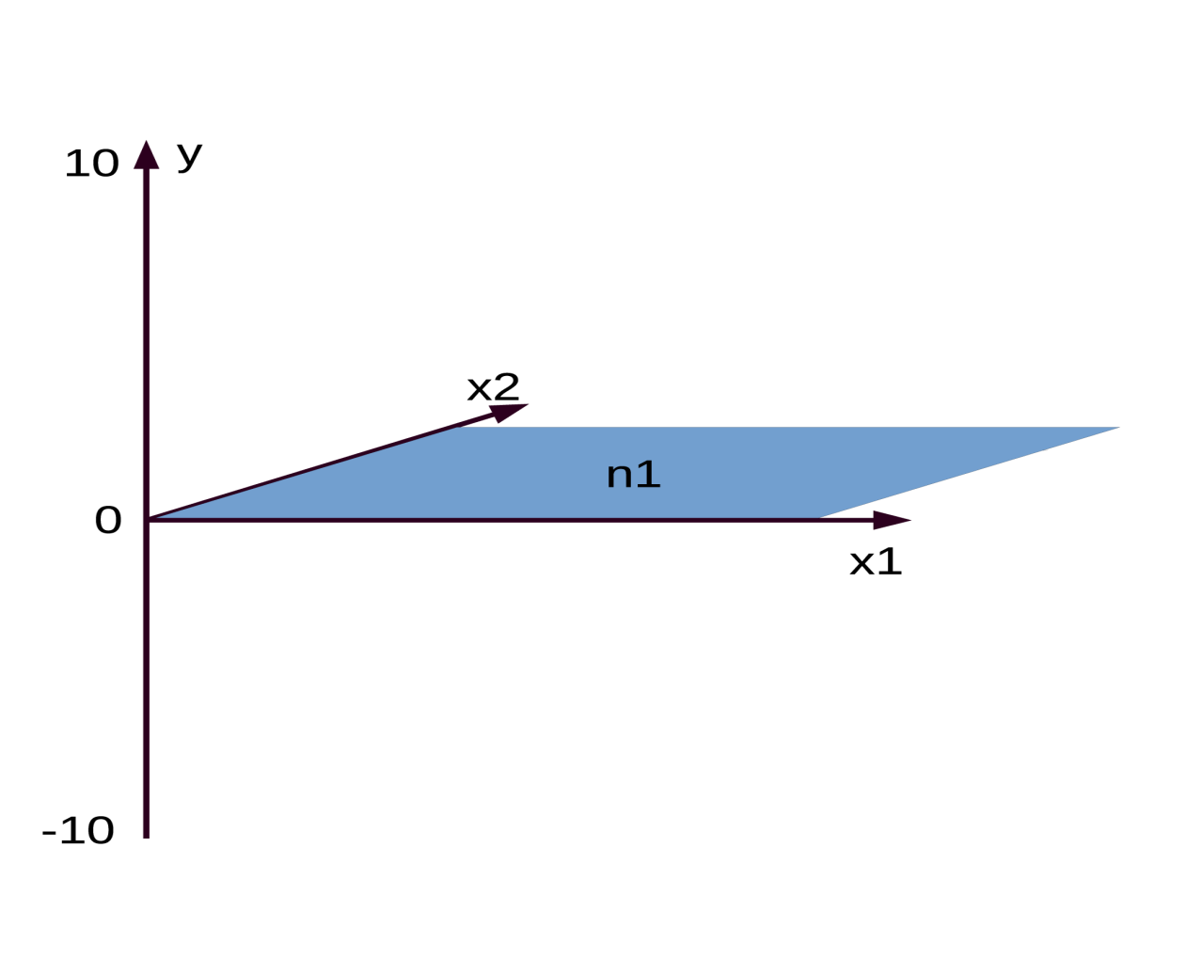
Two variables, one target, one grand mean(n1)
Mean is the prediction
$$\hat{y}=\overline{y}$$

Slide 58
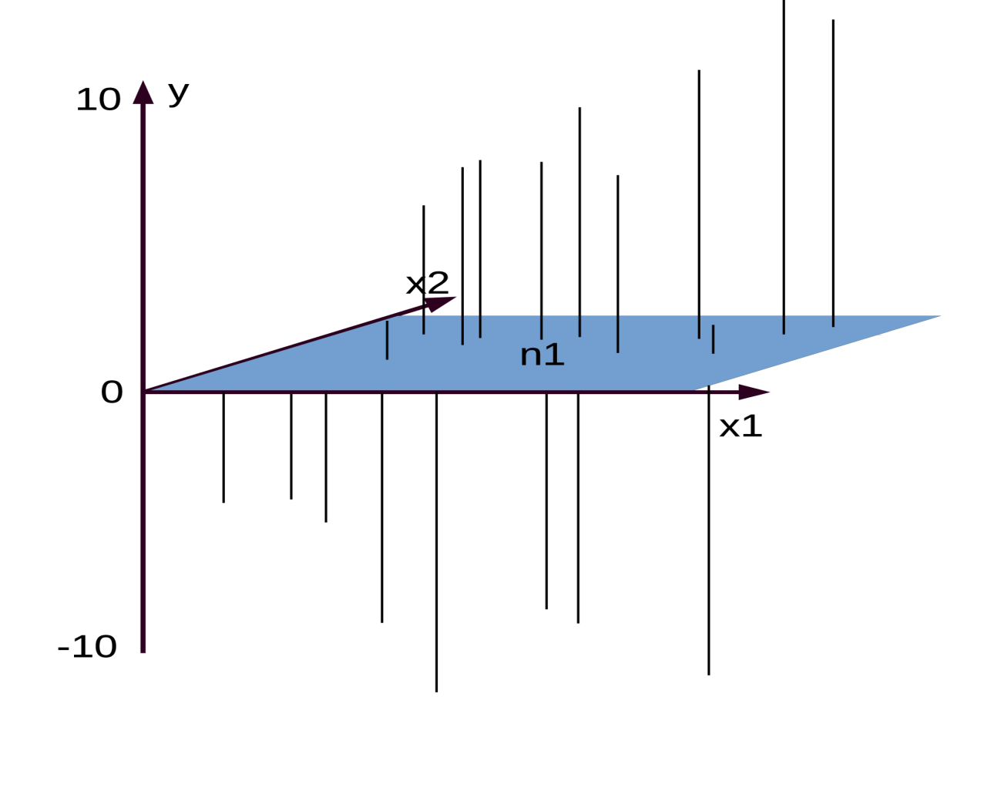
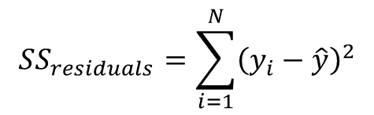
… and residuals of the grand mean
Sum of squares is error
$$SS_{residuals}=\sum_{i=1}^{N}{{\left(y_{i}−\hat{y}\right)}^{2}}$$

Slide 59
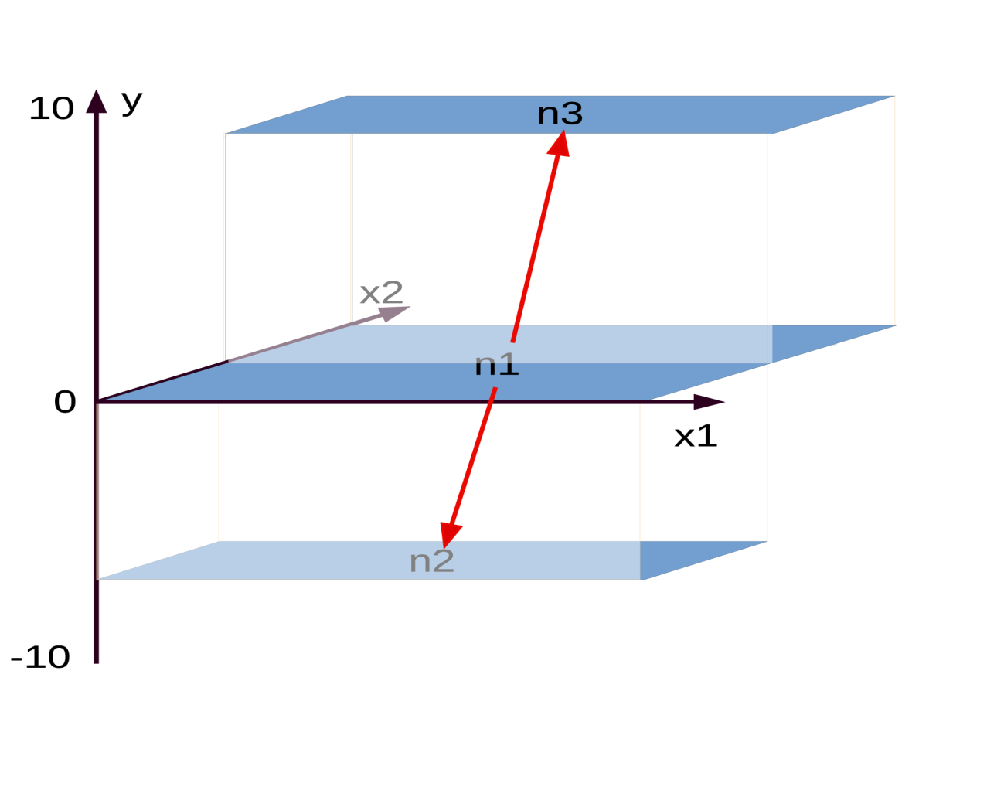
Best split of n1 by x2…
Best split gives lowest error

Slide 60
Best split of n1 by x2…
Repeat for each sub node!

Slide 61
Best split of n1 by x2…

Slide 62
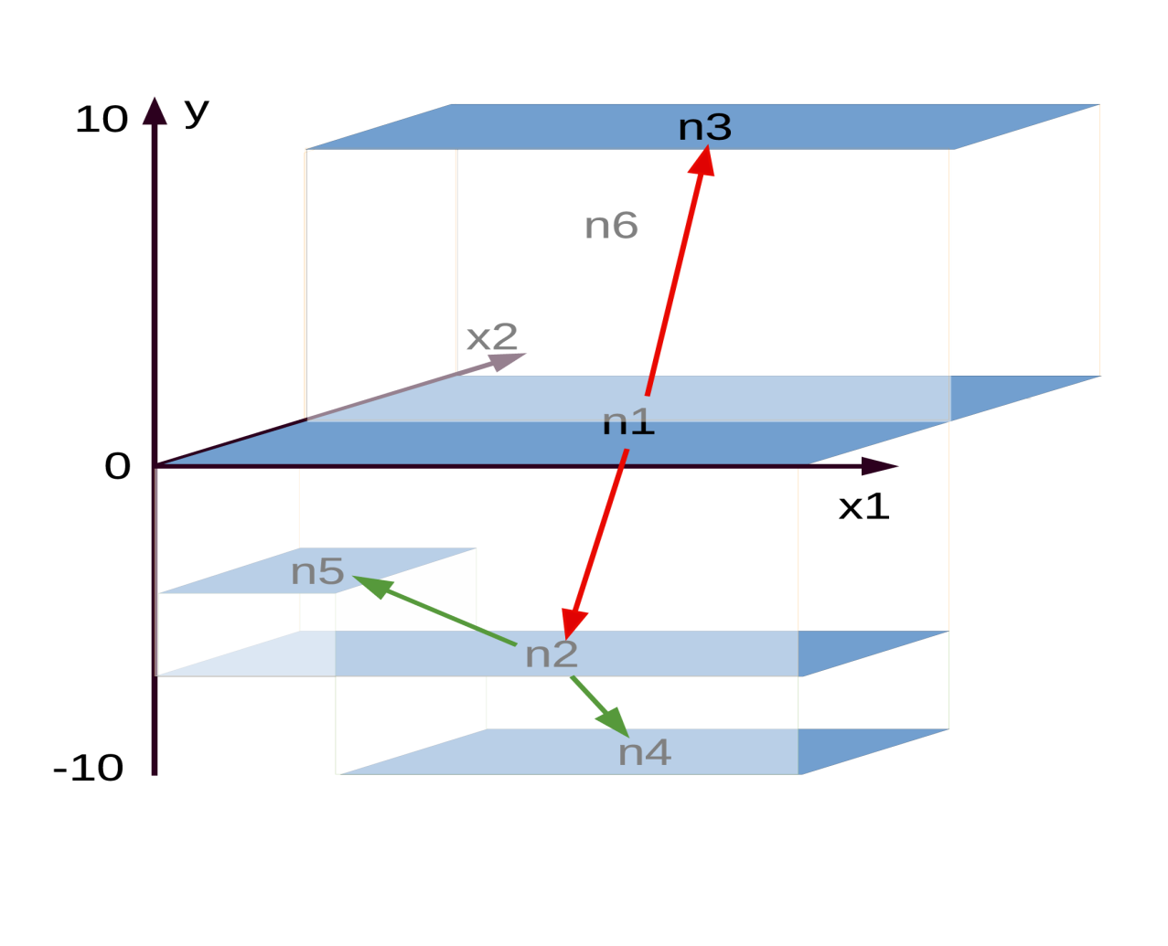
Best split of n2…

Slide 63
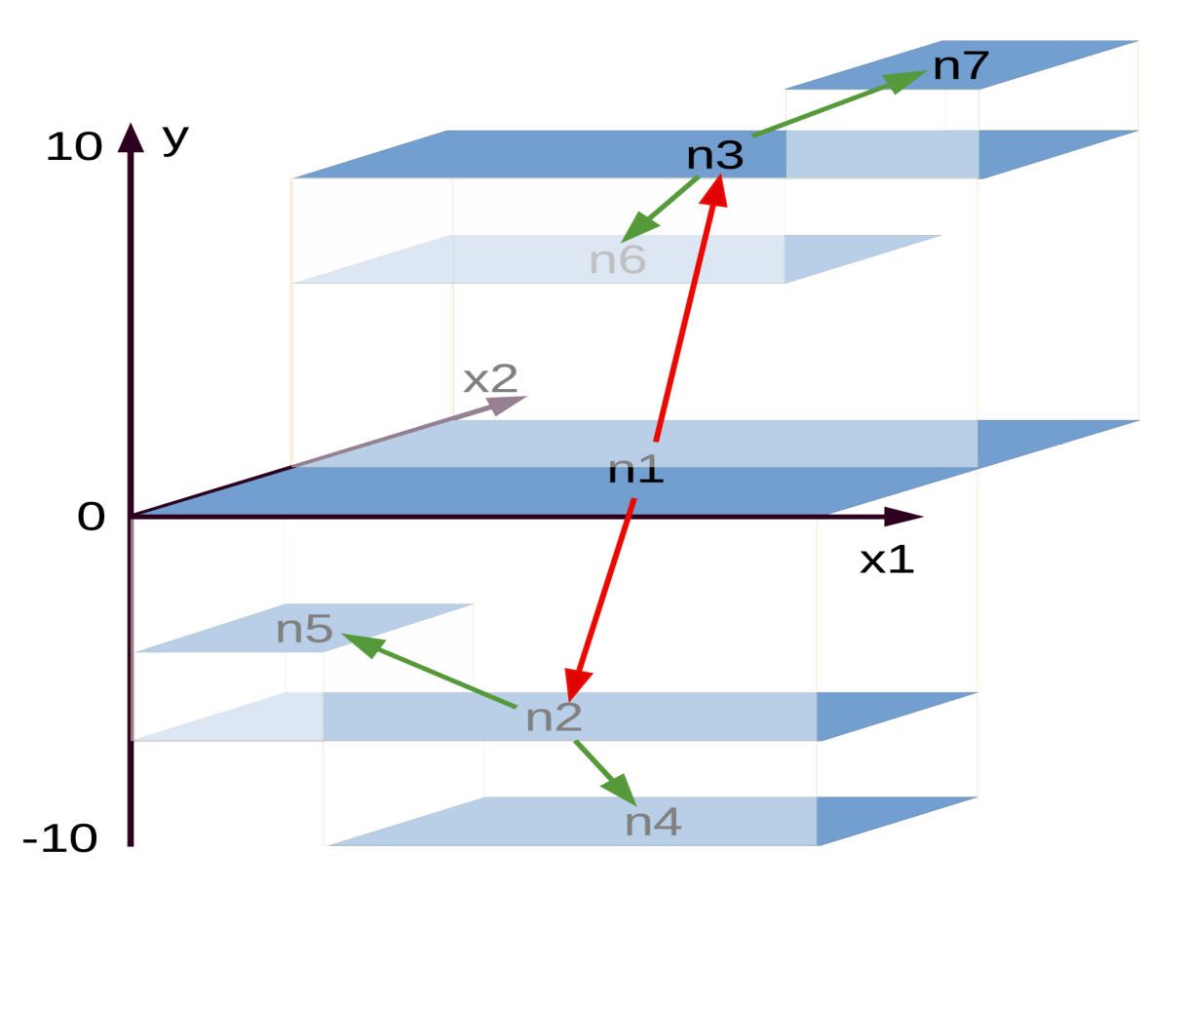
Best split of n3

Slide 64

data
sampsize
ntree
bootstrap
mtry
nodesize

Slide 65


Slide 66
library(forestFloor)
library(randomForest)
library(rgl)
#make data
X = data.frame(replicate(2,runif(2500)-.5))
y = -X[,1]^2 -X[,2]^2
#make color vector/gradient by y vector
ycolor = fcol(y,RGB = F,alpha=1)
plot(X,col=ycolor)
#or plot in 3D
plot3d(x= X[,1],y= X[,2],z= y,col = ycolor,size=6)
i=0
for(i in 0:50) {
#i=i+1
set.seed(1)
rf = randomForest(X,y,maxnodes = i,ntree=1)
vec.plot(rf,X,1:2,col=ycolor)
play3d(spin3d(rpm=20,axis =c(.5,0,2)),duration=3)
}
#train one single tree
rf = randomForest(x=X,y=y,ntree=1)
#getTree
Tree = getTree(rf,k=1)
class(Tree)
dim(Tree)
Tree[1:50,]
#function to plot surfaces or slices of model structures
vec.plot(model=rf,X=X,i.var=1:2,col=ycolor,grid.lines = 200)
dev.new()
par(mfrow=c(1,2))
for(i in 1:2) vec.plot(model=rf,X=X,i.var=i,col=ycolor,grid.lines = 1000,
main=paste("2D slice of model structure var:",i))
Growing a tree the movie!

Slide 67
Break!

Slide 68
Exercise: Random Forest
On learnmore
learnmore1.imm.dtu.dk
learnmore2.imm.dtu.dk

Slide 69
Diagnostics
Interpret Black Box Models
Søren H. Welling, Pharmatronics
Agnes Martine Nielsen, DTU Compute

Slide 70



A little follow up on random forests and bagging

Slide 71



Representations of models
Black box:
Ad hoc representations related to
Underlying algorithm
Mapping representations:

Slide 72





splitting model map in components
h₁(x₁)
h₂(x₂)
P+1 dimensions
=
+
+ …
x₁
x₂
algorithm finds h_{i} such that…
Main effects: f(X) = ∑_{p}h_{i}(x_{i}) + J_{o>1} (X)

Slide 73
Partial dependence example + dimension reduction by projection

Slide 74
ū₇=12
n= 52
ū₁=0.14
n=200
10
ū₃=10
n=82
X1 <= 0.8
X1 > 0.8
X₂ <= 1
X₂ > 1
ū₂=-7
n=118
ū₃=10
n=82
ū₆=6.5
n= 32
X₁ > 0.25
X₁ <= 0.25
X₁ <= 0.8
X₁ > 0.8
X₂ > 1
X₂ <= 1
ū₁=0.14
n=200
ū₆=6.5
n= 32
ū₇=12
n= 52
0
ū₄=-10
n=67
ū₅=-3
n=51
obs | X1 | X2 | FC1 | FC2 | Y
1 (LL) | 0.1 | 0.1 | -3-(-7) = 4 | -7-0.14 = -7.14 | 0.14+4-7.14 = -3
2 (UR) | 0.9 | 0.9 | 12-10 = 2 | 10-0.14 = 9.86 | 0.14+2+9.86 = 12
3 (UL) | 0.1 | 0.9 | 6.5-10 = -3.5 | 10-0.14 = 9.86 | 0.14-3.5-9.86 = 6.5
4 (LR) | 0.9 | 0.1 | -10-(-7) = -3 | -7-0.14 = -7.14 | 0.14-3-7.14 = -10
ū₅=-3
n=51
ū₂=-7
n=118
X₁ <= 0.25
X₁ > 0.25
-10
ū₄=-10
n=67

Slide 75
ForestFloor visual #1

Slide 76

Dear algorithm, figure this one out

Slide 77

The solution is…
$Y=G^{∗}\left(X\right)={\left(x_{1}\right)}^{2}+sin\left(x_{2}\right)+ \left(x_{3} ∙ x_{4}\right)+{0x}_{5}+0x_{6}$ + noise
x₁²
sinx₂
X₃(x)₄
X₄(x)₃

Slide 78


Slide 79


Slide 80
forestFloor example + interaction

Slide 81

splitting model map in components
h₂₄(x_{2,} x₄)
h₁₂(x_{1,} x₂)
h₁₃(x_{1,} x₃)
=
+
+
2nd order effects: f(X) = ∑_{p}∑_{p}h_{ij}(X_{ij}) + J_{o>2} (X)

Slide 82
wwq example
All random forest / forestFloor examples plus visualizations can be downloaded from
github.com/sorhawell/ffintro

Slide 83

Variable importance

Slide 84

End!

